Slide 1

Phishing website detection
Dr/ Mohamed Abo Rizka
Eng. Mohamed Moheeb

Slide 2


Meet our team
Mohamed Omar
Osama Khalid
Mohamed Amr Saleh
Ahmed El Sabaa
Karim Alaa

Slide 3
Agenda
Introduction
Example
objective
Decision tree (key)
Dataset
preprocessing
Decision tree (All)
Choosing key features
Overfitting repair
Actual decision tree
Logistic regression
Comparison

Slide 4
agenda
Introduction
Example
objective
Dataset
preprocessing
Decision tree
Decision tree (All)
Choosing key features
Decision tree Decision tree (key)
Overfitting repair
Actual decision tree
Logistic regression
Comparison

Slide 5

Introduction
Phishing website is a big threat to internet users because hackers want to get sensitive information about internet users like login credentials, credit card details or personal data, and this is a big threat to users because hackers may profit from this data so making predictions Phishing website is very important for protecting internet users and their online security.
The problem of predicting phishing websites can be framed as classification task, where the goal is to determine whether a given website is legitimate or a phishing website. This problem involves analyzing various features and characteristics of a website to make an accurate prediction.

Slide 6

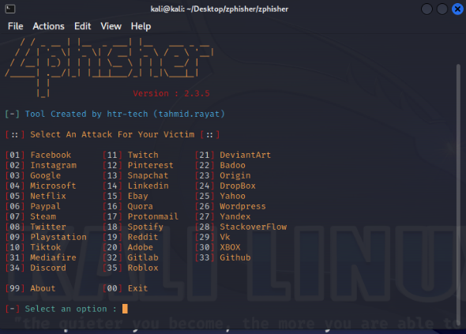
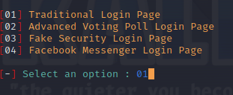
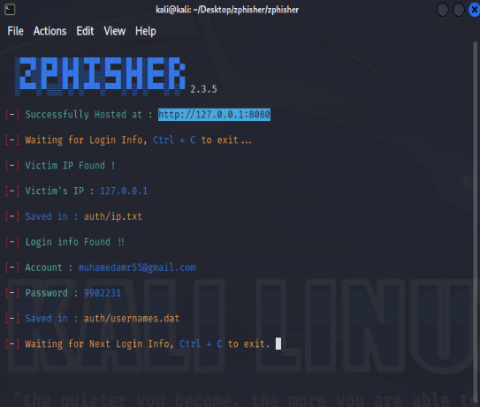
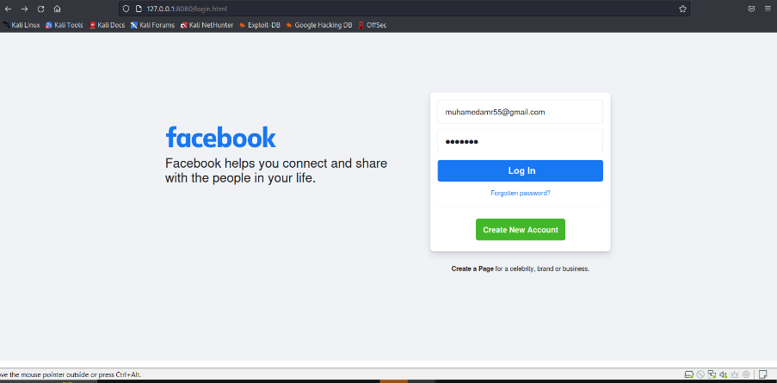
Example of phishing

Slide 7

Objective
The main goal of this project is to develop a predictive model that can accurately identify and classify phishing websites. The project aims to address the problem of online security threats posed by phishing attacks and provide a solution to help individuals, organizations, and internet users in general
This will help us to get real accuracy in determining the URL class and help internet users to suffer the internet safely•
The input is an URL and then the tools will parse the URL into twelve important features which have a great effect in determining the URL category and then the values will be stored in an array to get the URL result is phishing website or legit website.

Slide 8

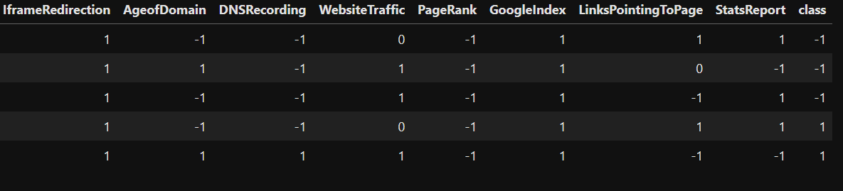
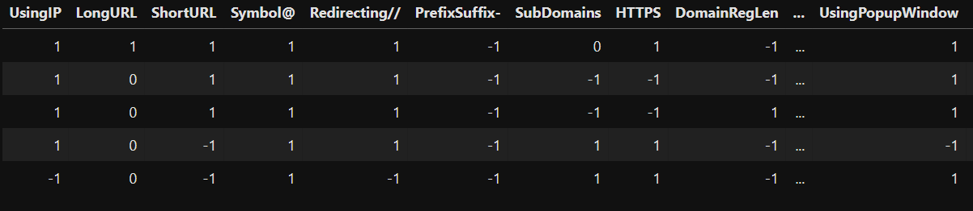
dataset

Slide 9

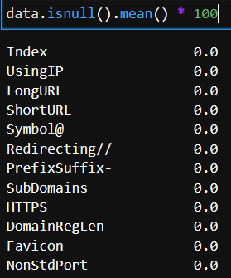
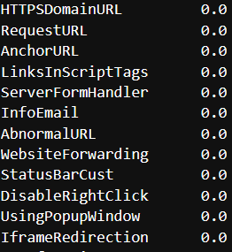
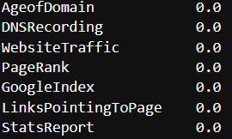
Data preprocessing

Slide 10

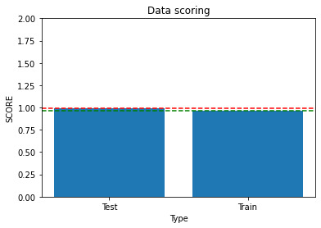
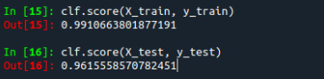
Decision tree Train and Test accuracy before choosing key (All) features and their accuracy.
Observed the overfitting

Slide 11

choose features that have huge effect on detecting phishing websites using correlation.
Features | class
HTTPS | 0.714704
Anchor URL | 0.692895
Prefix Suffix | 0.348588
Website Traffic | 0.346003
Sub Domains | 0.298231
Request URL | 0.253478
Links in Script Tags | 0.248415
Server Form Handler | 0.221380
Google Index | 0.129000
Age of Domain | 0.121402
PageRank | 0.104593
Using IP | 0.094033

Slide 12


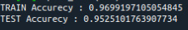
Plotting decision tree with chosen important features data

Slide 13

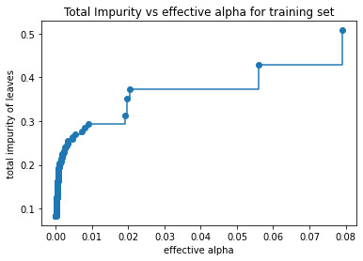
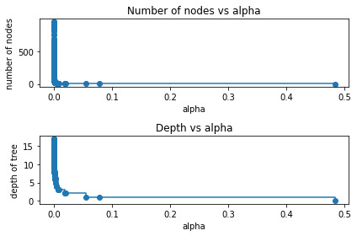
overfitting repair using ccp

Slide 14

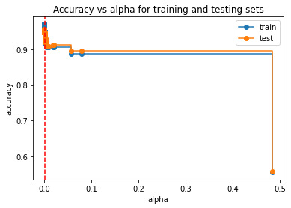

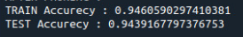
Get all possible alpha data based on train and test data and then create every possible tree and then get minimum distance between train and test data for each tree to get the best alpha

Slide 15
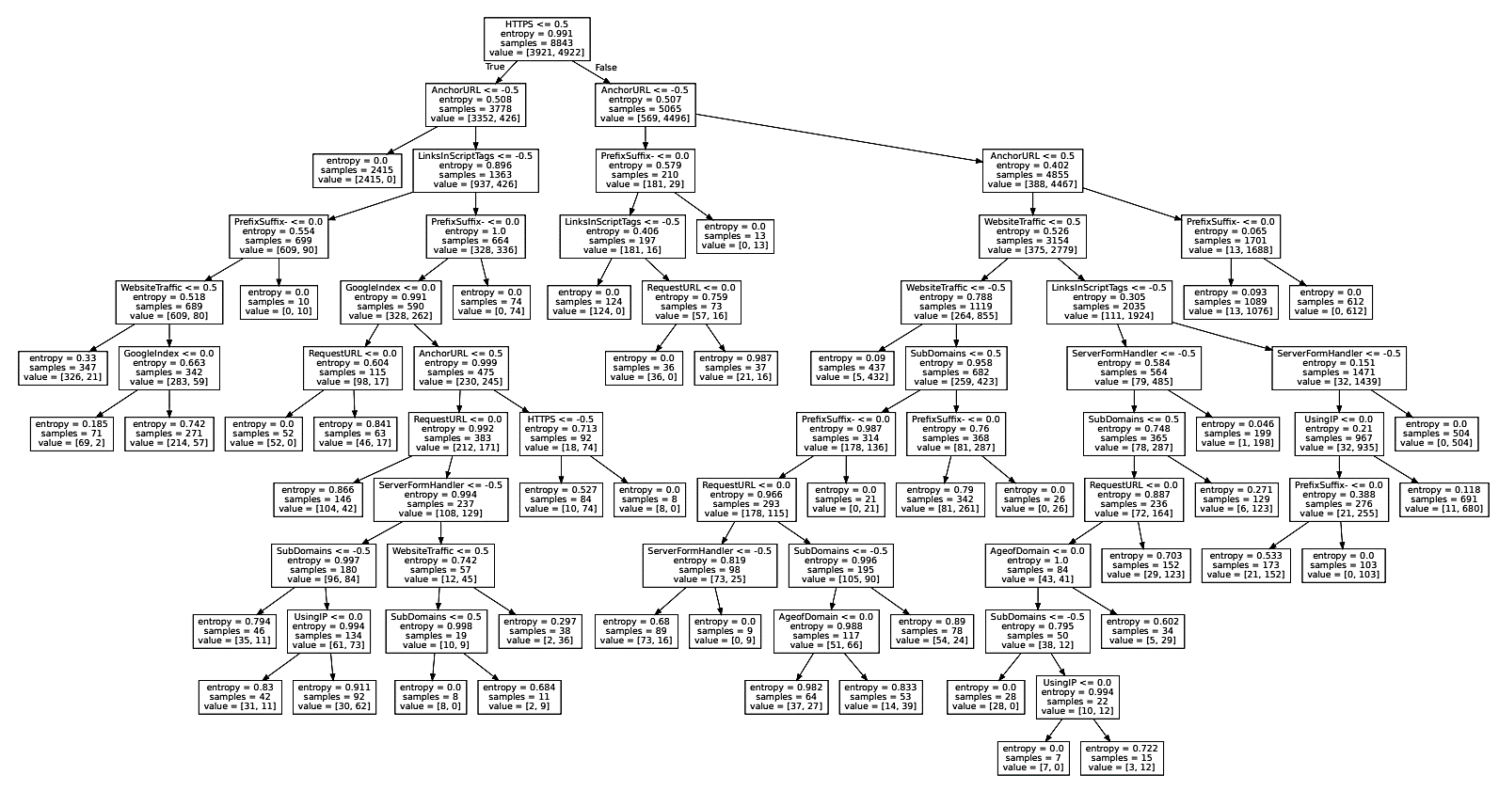
Decision tree

Slide 16

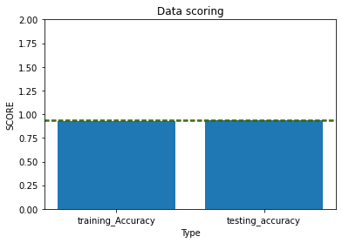
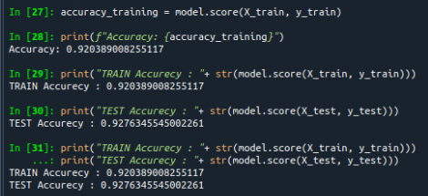
Logistic regression

Slide 17

Result

Slide 18

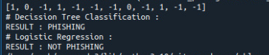
Input URL
http://shadetreetechnology.com/V4/validation/a111aedc8ae390eabcfa130e041a10a4

Slide 19



Decision tree
Logistic regression

Slide 20

Thank you

